Slide 1
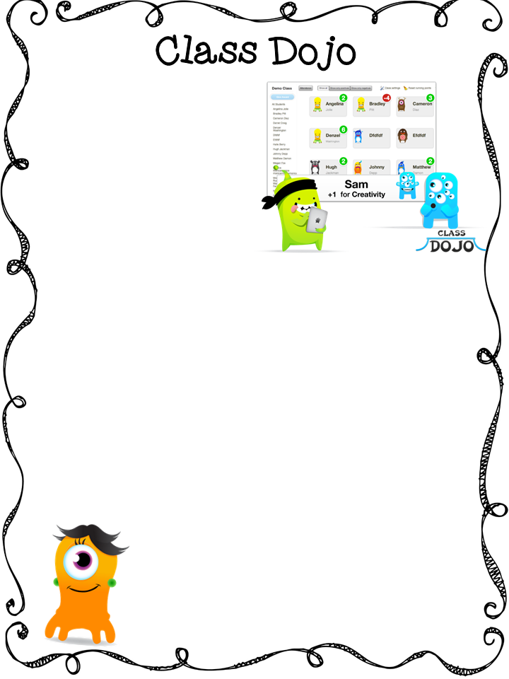
I wanted to tell you about a behavior tool I am going to start to use in my Class Dojo. It is a website that allows teachers to give students immediate feedback on their behaviors, positive and negative. Students get very excited when they are awarded points and one of the things I am hoping for is that they will even root for each other!
One of the great features of Class Dojo is that it allows me to send you a “behavior and skills report” every Friday in their backpacks. My hope is that this will bring us closer together, and help you better understand the progress of your student on a week to week basis.
Students are also able to have their own account using a special code so they can customize their monsters avatars on their own!
I know you will be proud to see the great behaviors they are displaying, and in turn, if there is something they need to work on, you will be able to see that as well.
Please fill out this form so I can get your email address to send an invite. You will need to respond to the invite to confirm your account and then you will be all set up!
Thank you for your continued support!
Mrs. Listenberger
Student Name: ______________________________________________
Parent Name: _______________________________________________
Your email address: ________________________________________

Slide 2
Font used is: Hello Basic

